Slide 1
Lesson 6
Introduction to MS Word
Tables

Slide 2
What are tables?
A table is one or more rows of cells that are often used to display numbers and other data for quick reference and analysis.
A table consists of rows and columns of cells , which you can fill with text and graphics.
Tables are often used to organize and present information.
Source: http://www.lib.uth.gr

Slide 3
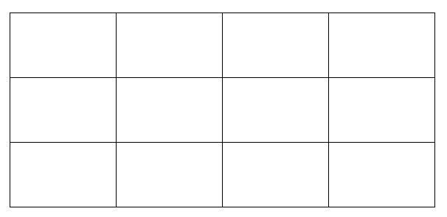
Table Examples

Slide 4
Table Formatting
Just as we format text that we saw in previous lessons, we format text in tables in the same way.
In the same way, we can define in a table:
  Font
  Bold Writing
  Underlining
  Italic writing
  Font color
  Font size
  ... etc.

Slide 5
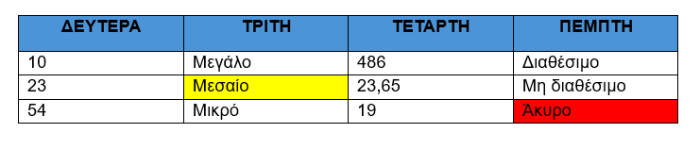
Table Examples (2)

Slide 6
Rows – Columns – Cells
COLUMNS
LINES
CELL

Slide 7
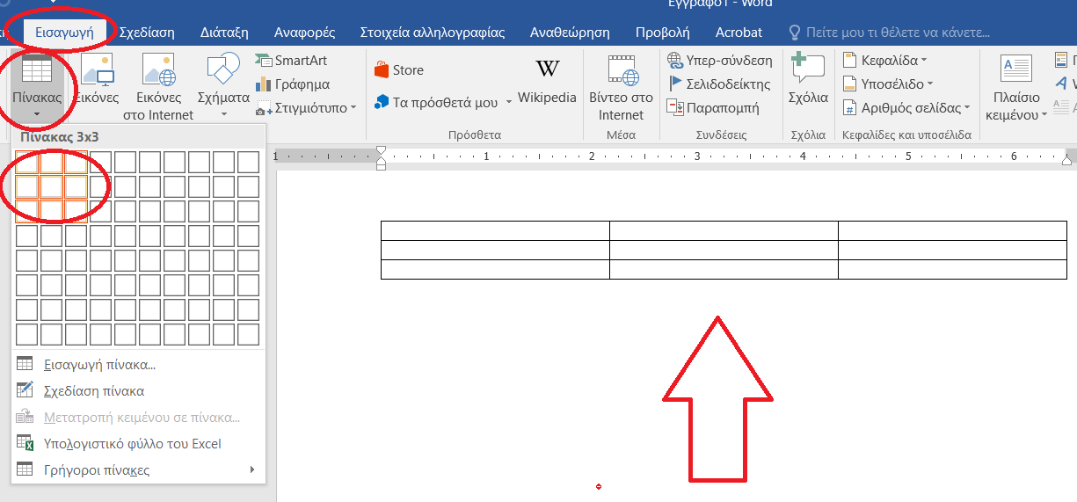
Table Insertion

Slide 8
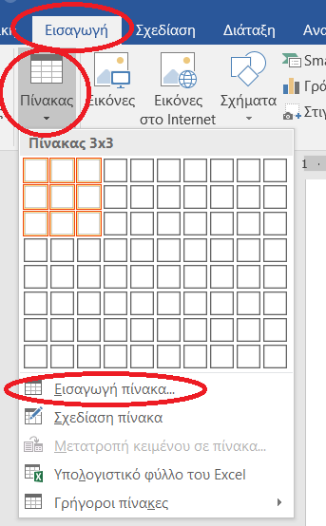
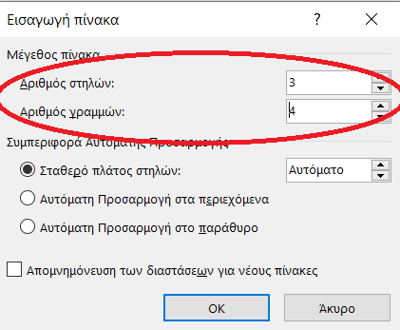
Table Insertion – ^{2nd} Method
2
1

